Slide 1
Dreams, Dreaming and the Subconscious

Slide 2
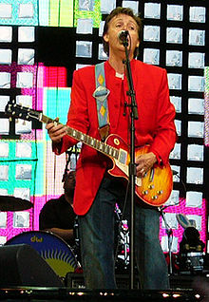
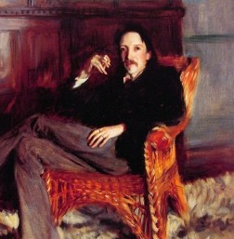
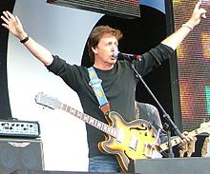

Slide 3
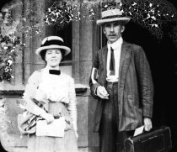
Sir Arthur Tansley, a botanist who later became a psychologist
famous for the idea that ecosystems are self-organizing

Slide 4
Marc Chagall, His paintings have a few distinct images in an unlikely association that would be bizarre in real life, but typical of images we see in dreams. Perhaps this spontaneity and ability to express a dream-world is why his work is so loved

Slide 5
Chagall, Cow with a parasol
Cows have different meanings to different people, in different cultures.
Any image will have a different meaning depending on the dreamer and the context.

Slide 6
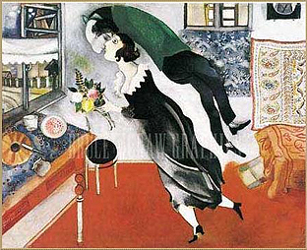
Sometimes we’re so happy we feel like we’re floating on air, like being in a dream

Slide 7
Left Brain Right Brain
http://psychology.about.com/od/sensationandperception/ig/Optical-Illusions/spinning-dancer-illusion.htm
http://www.heraldsun.com.au/news/right-brain-v-left-brain/story-e6frf7jo-1111114603615

Slide 8
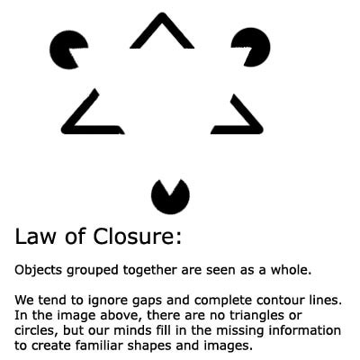
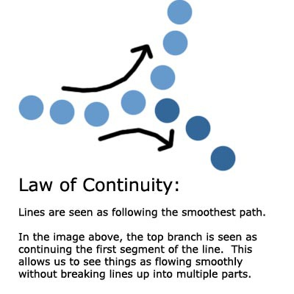
Confabulation: Psychology To fill in gaps in one's memory with fabrications that one believes to be facts.
Gestalt Laws of Perceptual Organization
Our brains often ignore contradictory information and fill in gaps in information.

Slide 9
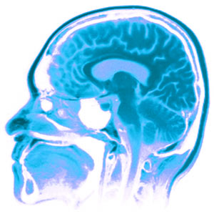
The Three Pound Universe What is this thing we call a brain?
Franklin Institute, Center for Innovation in Science :
a thinking organ
learns and grows by interacting with the world
learns by perception and action.
Mental stimulation improves brain function
The human brain is able to continually adapt
-Can rewire itself
-Has a 85 billion neurons
-can grow new neurons.
-use it or lose it.
Notes:
What is this thing we Call a brain?

Slide 10
Minds, Brains, and Machine
What do we have in common ?
What makes a Human different from a Computer?
Notes:
Jeff Hawkins vs Dr. Kristoff Koch (Brain Institute)
2011 Symposium at MIT
The importance of teamwork
At a panel titled “Social Cognition and Collective Intelligence,” scientists delved into the phenomenon of humans pooling their intelligence, sometimes aided by computers. Moderator Thomas Malone, director of MIT’s Center for Collective Intelligence, noted in his introduction that “intelligence is not just something that happens inside individual brains. It also arises within groups of individuals.”
For thousands of years, groups such as families, countries, armies and companies have been behaving in ways that seem intelligent. More recently, the Internet has expanded collective intelligence even further, with the development of sites such as Wikipedia and Google that make it easy to consolidate individual contributions.
Humans and computers working together can form a collective far more intelligent than any single person or computer, Malone said.
“As the world becomes more and more highly connected, through all kinds of electronic devices, it will be increasingly useful to think of all humans and computers on the planet as a single global brain,” he said.
_____________
Are we all robots? Is our DNA the 0's and 1's of computer code? Are we an advanced computer system, with instead of keyboard and mouse input... input from our senses. Our database being our brain to process all the information. Our offspring just a code merge from two existing chemical computers. Instead of a socket to run the CPU, we create are electricity from food. Do we make our own decisions or is our brain just advanced logical circuit board of if/else statements making decisions from the vast input our senses give us?
If there is a difference, what is it?

Slide 11
Minds, Brain, and Machine
Both:
Both use electrical pulses
Can communicate
Transmit information
Have memory that grows and can be expanded, supplemented
Adapt and learn
Evolve with time
Need Energy
Can be Damaged
Change and can be modified
Speak
What about thinking?

Slide 12
Coma means deep sleep-
but is it deep sleep?
Notes:
For a patient to maintain consciousness, two important neurological components must function.
The first is the cerebral cortex—the gray matter that covers the outer layer of the brain.
The other is a structure located in the brainstem, called reticular activating

Slide 14
Is it possible to share Thoughts and dreams?

Slide 15
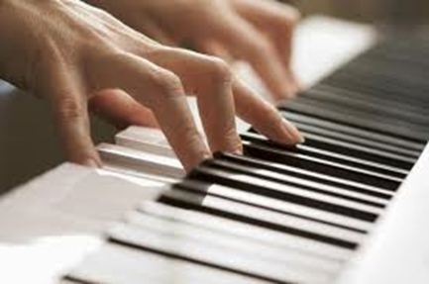
Clive Waring
He has no short-term memory but has implicit memory

Slide 16
Are you a dreamer?
http://www.youtube.com/watch?v=9yJE1iiO0qI

Slide 17
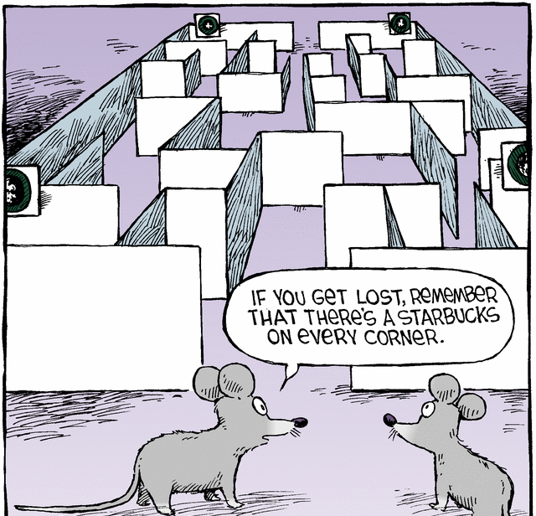
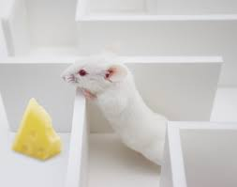
Theory (#2 of 6) Matt Wilson, MIT Center for Learning and Memory Dreams Create Wisdom
“Sleep turns a flood of daily information into what we call wisdom:
the stuff that makes us smart for when we come across future decisions”
we encode memory to long-term memory when we sleep
Dreams sort through memories, to determine which
ones to retain and which to lose.
His test: He put rats in mazes during the day & recorded what neurons fired in what patterns as the rats negotiated the maze. In REM sleep, the same neuron patterns fired that had fired at important turning points in the maze.
In other words, he saw that the rats were dreaming of important junctures in their day.

Slide 18
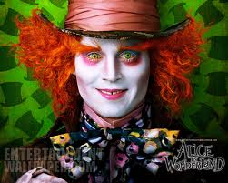
MRI: your brain watching a movie
Alice in Wonderland https://www.youtube.com/watch?v=1BWWkXdOui4&index=5&list=UUbDdmTlTwoCUx2p7nScbUCw
Avatar
http://www.youtube.com/watch?v=KSKIkXvqruI&list=UUbDdmTlTwoCUx2p7nScbUCw&index=4&feature=plcp

Slide 19
If a tree falls in your dream, why does it make a sound?

Slide 20
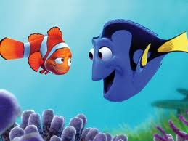
Memory
3 systems:
Short term- active memory
7 things
7 seconds – 30 seconds
Sensory- from senses and experiences
Long term- is stored memory
About 86 billion neurons in a brain
Explicit (declarative) Conscious
Implicit (procedural) Subconscious

Slide 21
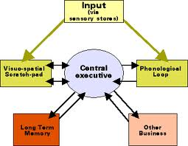
Memory
Working Memory
Central Executive, Prefrontal lateral cortex (PFC)
WM includes Short Term Memory
But not all memory goes
to long term Memory
Some memories are never in dreams- can you guess why??

Slide 22
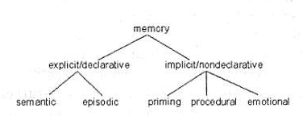
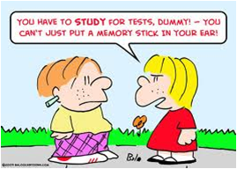
EXPLICIT MEMORY IS CONSCIOUS:
Explicit Memory is the deliberate recollection of a memory; it’s specific,
the kind of memory we think about or draw upon countless times a day
Episodic (long-term)
Specific
Autobiographical
Emotional
Includes flashbulb memory
Semantic (long term)
General knowledge
Not unique to individual

Slide 23
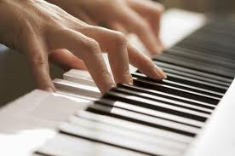
IMPLICIT MEMORY
LONG TERM MEMORY
SUBCONSCIOUS
Not specific
separate from explicit memory
operates through a different process in the brain
Procedural
Automatic sensorimotor behavior
(walking, playing a guitar, shooting baskets)
Emotional Memory (love, fear)
Automatic
Muscle memory (how to hold a pen)
Priming
How deep and how vast is our mind? Is that what dreams are?
Clive Waring: http://www.youtube.com/watch?v=Vwigmktix2Y

Slide 24
Sleep is important for memory
sleep before learning, is necessary because it prepares you to learn
the next day
sleep after learning is essential: it grabs onto the new information and cements the information in the neural architecture of the brain.
Sleep is like a save button, protects the memory and strengthens memory
Sleep intelligently cross links large sets of information, seeks out patterns, rules of all that information and creates novel insights.
Problem solving (the expression: sleep on it)
If sleep deprived, about 40% impairment in capacity to learn

Slide 25
Memory Systems
Synaptic consolidation- within a few hours of learning
(when awake)
Systems consolidation- over days, weeks, maybe months
(when we’re asleep)
Even years later
Memory reconsolidation and Updating consolidation

Slide 26
MEMORY TRIAGE: (Acquisition | consolidation)
While we sleep our brain processes new information in a discriminatory manner
it picks and chooses what to keep
assimilates the memory into a
vast library of evolving knowledge
Encoding and Sleep Consolidation
Not everything is remembered-
For information that is retained, sleep integrates it into existing memory by:
looks for common patterns
Consolidates memories
Or, simply cement and strengthen the memory exactly as it was learned

Slide 27
How does the brain choose what memory to consolidate?
“TAGS”
If not tagged, sleep will forget memories it decides you don’t need
How to make sleep cement a memory?
For example: If you think you will be tested, your brain will remember it
Tags might be:
emotional
you were excited about it
pleasurable
made you happy
When does sleep consolidate memory?
In stage 3 and 4 deep slow-wave sleep (Non-rem sleep)

Slide 28
OUR COLLECTIVE MEMORY
Three memories
1 flashbulb memory (explicit and specific)
1 semantics/ not important
1 procedural (implicit and general)

Slide 29
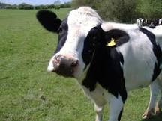
Dreams include images and memories
Episodic Memory
Memories which are actually perceived and known;
Specific
Autobiographical
Emotional, such as love, fear
Includes flashbulb memory
Procedural memory
Procedural is the steps to doing something, or learning to do it
Procedural memory includes muscle memory (how to play piano)
Semantics
general knowledge, NOT unique to individual
symbols and meanings that the symbol emotes
long term memory and implicit
Perceptual memory
Conceptual memory
Abstract
Notes:
1. Episodic
Memories which are actually perceived and known;
For Ex: An actual memory of riding your bike to school
the day you almost got hit by a car. A distinct memory/event
2. Procedural memory
Procedural is the steps to doing something, or learning to do it; Learning How to ride a bike
3. Semantics
Semantics are long term memory;
it is the symbols and meanings that the symbol emotes (with a feeling), or connects in general to something, but not an actual specific experience or a specific thing.
Semantics are general knowledge
Dreams are filled with metaphors and semantics mixed in with episodic memory and learning
Think of everything we put into our brain, (some of it is your thoughts and some is not. Some is nonsense and some is not) and then think about what ends up in your dreams)

Slide 30
Calvin Hall: Dreams are a cognitive process
The goal is not to understand the dream-
But to understand the dreamer
Analyzed thousands of dreams from diaries
Developed a quantitative coding system for content
Looked for patterns
Methodical, empirical
Believed meaningful predictions could be made about
dreamer’s behavior and lifestyle
Dreams provide a path to the unconscious areas of the mind,
and can be a map for the dreamer to anticipate difficulties and obstacles

Slide 31
One picture is worth a thousand words
A dream is a work of art
Metaphor isn’t necessarily a metaphor
It can be a pun or a slang
He didn’t think dreams were a disguise
not hidden expression
Dreams provide a path to the unconscious areas of the mind,
and can be a map for the dreamer to anticipate difficulties and obstacles

Slide 32
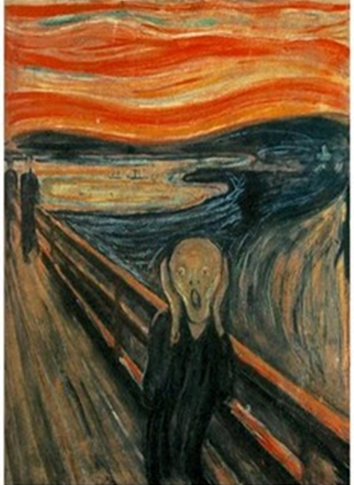
Calvin Hall: Dreams are a cognitive process
Concepts of Self
refer to the types or number of roles you play in your dreams
Concepts of other people are the roles other people play
in your dreams. Consider your feelings toward them and how
you interact with them
Concepts of the world represent the dream surrounding
and landscape. The adjectives you use to describe your
dreamscape is how you view the world.
Concepts of impulses, prohibitions and penalties
indicate your behavior and how it is ruled by impulses and
punishment.
Concepts of problems and conflicts symbolize your
struggles, issues and problems you are facing in your waking life.
Dream try to offer insight and resolution to your conflicts.

Slide 33
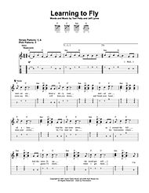
Quick break if you want…
And making a dream
Learning to Fly live : 5 minutes http://www.youtube.com/watch?v=4p_f7Df2-oM&feature=related

Slide 34
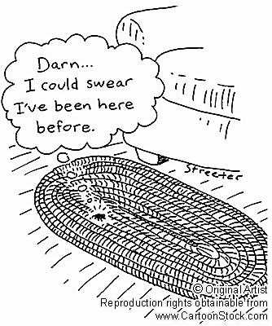
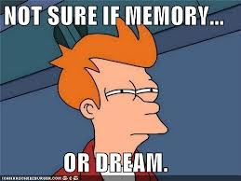
Deja Vu
Schema
Encoding
Confabulation
Precognition
Flow/ astral plane

Slide 35
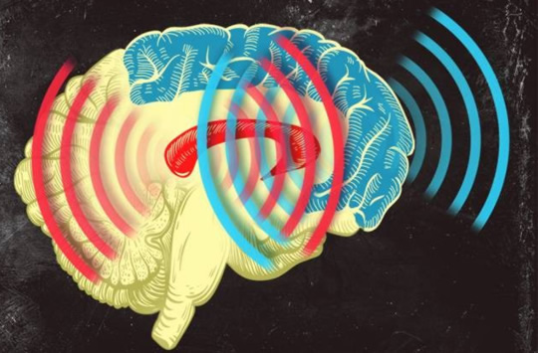
Synchronized Brain Waves enable rapid learning; new research 2014
Professor Earl K. Miller, MIT neuroscientist,
“If you can change your thoughts from moment to moment, you can’t be doing it by constantly making new connections and breaking them apart in your brain. Plasticity doesn’t happen on that kind of time scale.
There’s got to be some way of dynamically establishing circuits to correspond to the thoughts we’re having in this moment, and then if we change our minds a moment later, those circuits break apart somehow.” Category-learning results in new functional circuits between these two areas, and these functional circuits are rhythm-based…
When learning, the brain produces beta waves.
The striatum activates first, sees the pieces of the puzzle, then the prefrontal cortex puts the pieces together, working in sync with the striatum.
Prefrontal Cortex (blue)
& the Central Executive
Striatum (red)
Memory formation
Notes:
When learning, the brain produces beta waves. The striatum activates first, sees the pieces of the puzzle, then the prefrontal cortex acts and puts the pieces together, working in sync with the striatum. Category-learning results in new functional circuits between these two areas, and these functional circuits are rhythm-based,

Slide 36
Henri Rousseau, The Dream, 1910 Rousseau never went to Africa, but at the time, travel books were very popular and widely read, not unlike we watch tv today as entertainment.

Slide 37
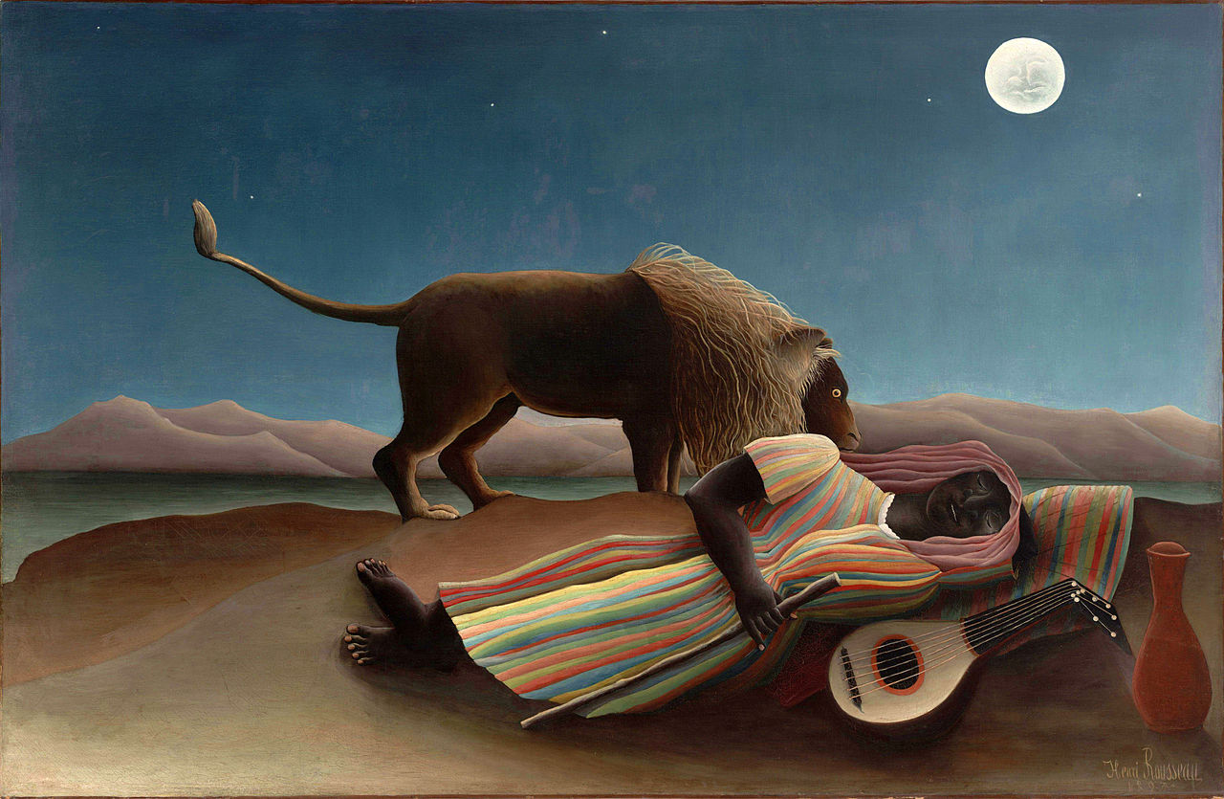
Henri Rousseau, the sleeping gypsy, 1897

Slide 38
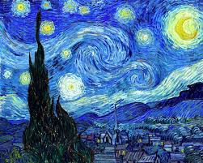
Vincent Van Gogh: Starry night, 1889
it depicts the night-time view outside his sanatorium window in Saint-Remy-de province

Slide 39
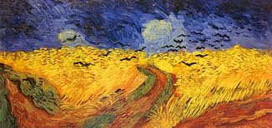
Vincent Van Gogh: Wheat Field with Crows, 1890 Akira Kurowsawa: Crows, 1990
“You're an artist, aren’t you?”
https://www.youtube.com/watch?v=sJ90m9y4fx8&feature=related
https://www.youtube.com/watch?v=TgSIRjyQOgA

Slide 40
Parasomnia
Sleep talking (Somniloquy)
Sleep walking
These happen when we’re partially awake, and ‘stuck’ between deep sleep and awake
may be hereditary
occurs more often with a fever

Slide 41
Theory (#3 of 6) Francis Crick: Dreaming is Like Defragmenting Your Hard Drive
"we dream in order to forget."
The brain is a machine that connects data in the same way as a matter of habit, (not always useful to do this)
When we sleep the brain fires more randomly and establishes new connections and pathways
Dreaming shuffles old connections that allows us to keep the important connections and erase the inefficient links
A good analogy here is the defragmentation of a computer's hard drive: Dreams are a reordering of connections to streamline the system

Slide 42
MUSIC for listening Free falling john mayer live (great 4 minutes (10 sec, com) http://www.youtube.com/watch?v=20Ov0cDPZy8 Learning to Fly live : 5 minutes http://www.youtube.com/watch?v=4p_f7Df2-oM&feature=related sky sailing Brielle 4. minutes http://www.youtube.com/watch?v=_PkzsMak6P8&ob=nb_av2e In Dreams 2.5 minutes Roy Orbison http://www.youtube.com/watch?v=zbxsmcT7GOk MOVIE CLIPS/ USE FOR IMAGES and SYMBOLS
Eli stone http://www.youtube.com/watch?v=08tPHCdha34&feature=related
Harper Simon - Wishes and Stars http://www.youtube.com/watch?v=d82Dz1DW2BM&feature=related
1. Peach orchard esp. 3 minutes- 7 to understand http://www.youtube.com/watch?v=1qMqTZ-Jnbw&feature=related 2. Kurosowa w/ music from Enya. 3.5 minutes edited and merging of dreams with music by Enya Is Kuorsoawa asking himself: " Am i Van Gogh? " http://www.youtube.com/watch?v=sJ90m9y4fx8&feature=related
3. summary of movie DREAMS 2.5 minutes PHENEMOMINAL!!!!!! http://www.youtube.com/watch?v=oTRw66CnWLI&feature=related
Kurosowa Blizzard: Start at 2,50 – http://www.youtube.com/watch?v=5Af-DZkRyzk&feature=related
Part 3 trumpet music at 2,25 sees tent…
http://www.youtube.com/watch?v=cEDk5ysFiuw&feature=related
blizzard, not original - 7 minutes
http://www.youtube.com/watch?v=2TbDSi_K-FY&NR=1&feature=fvwp Billy Joel river of dreams http://www.youtube.com/watch?v=hSq4B_zHqPM

Slide 43
sources
Minds, Brains, Machine Larry Hardesty and Anne Trafton, MIT News Office May 9, 2011
http://newsoffice.mit.edu/2011/mit150-brain-ai-symposium
Synchronized Brain Waves Enable Rapid Learning; MIT 2014 Research:
http://newsoffice.mit.edu/2014/synchronized-brain-waves-enable-rapid-learning-0612
Memory: http://learnmem.cshlp.org/content/11/6/671.full

Slide 44
Starry Night, Don McLean https://www.youtube.com/watch?v=oxHnRfhDmrk
Enya; Kurosawa Dreams, Van Gogh- 3 minutes
https://www.youtube.com/watch?v=sJ90m9y4fx8&feature=related
Waking Life on Netflix
:http://video.google.com/videoplay?docid=7583894250854515095#
http://www.netflix.com/WiSearch?raw_query=&ac_category_type=none&ac_rel_posn=-1&ac_abs_posn=-1&v1=waking+life&search_submit=

